Slide 1
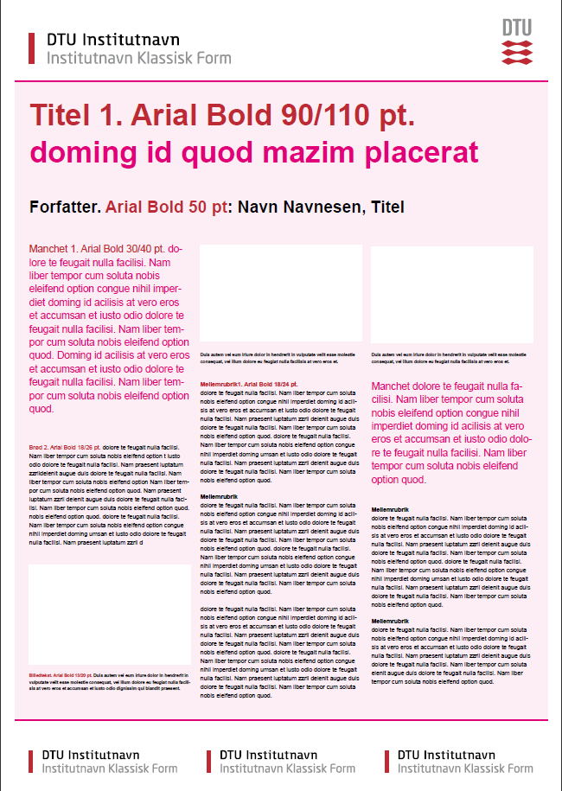


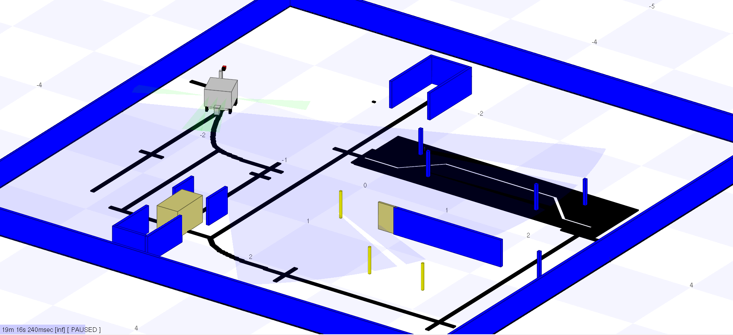

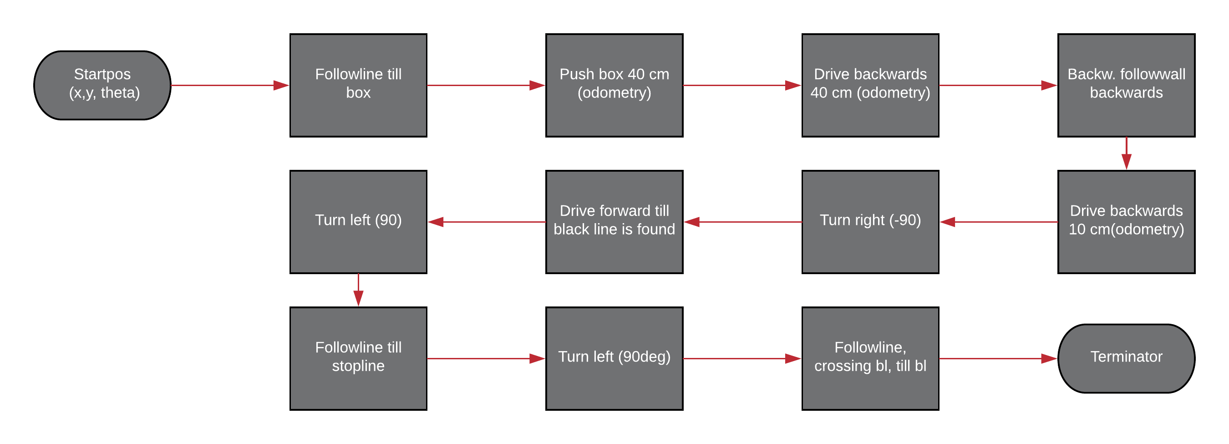

31385 AUT Robot Systems
s163926 Anders Hilmar Damm Andersen
s163924 Christian Kampp Kruuse
s163933 Asger Johan Kühl
s163935 Mads Holmark Vandborg
Robot Competition
A competition between the different teams at the course was held.
6 obstacles were meant to be solved correctly by the SMR(Small Mobile Robot) to obtain points and the final score was an evaluation of the total points as well as the completion time.
Indsæt billede<
Indsæt billede<
Figure 1 a screenshot of the simulation for testing the SMR in a perfect world
Software development
The purpose of the course was to develop software for controlling the SMR through the final competition.
SMR_CL vs C
A specific scripting language called SMR_CL is designed to control the SMR.
The overall task is therefore implemented by both the SMR_CL and in C in which the final competition is held for each script.
SMR_CL is effective in the sense that it is easy and fast to write tasks in this, while the C-code is useful when you need complete control of the SMR.
PID Where, when and why
A PID c ntrol has been implemented for use when steering, using external sensors. An example is when the infrared sensors is used to follow a wall, where this approach ensures a steady distance to the wall, while also enabling the robot to get around corners, without having to know there is a corner. Calibrating this PID however, has been an ongoing challenge, as the IR sensors are very sensitive to the ambient lighting, forcing the user to calibrate them before every new run, assuming the lighting will stay constant during the calibration and run.
Calibration
An important part of the difference between
simulation and real world is the calibration of the sensors according the real world conditions. The conditions vary with the outside weather, and especially strong sun can interfere with the IR and line sensors.
A calibration of the IR and line sensors is therefore essential for making the robot act optimally outside of a simulation.
Obstacle nr. 2 ‘Box gate’
Every obstacle of the final competition was planned independently of each other starting with flowcharts, simulation and testing in real world conditions.
Figur 2 flowchart for the obstacle
‘Box gate’

